Slide 1
QR REPLACE
Made by Nathan, aaron, Jacob, and goutham

Slide 2
Software Process
QR CODES have three corners where the ratio of the pixels is 1:1:3:1:1.
The goal was to detect the corners of the QR code
Then orient the image so that the QR Code was properly detected
Replace the original image with a properly oriented QR code.

Slide 3
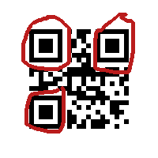
Detection
Scans through the image
Finds ratio
Determines midpoint of ratio

Slide 4
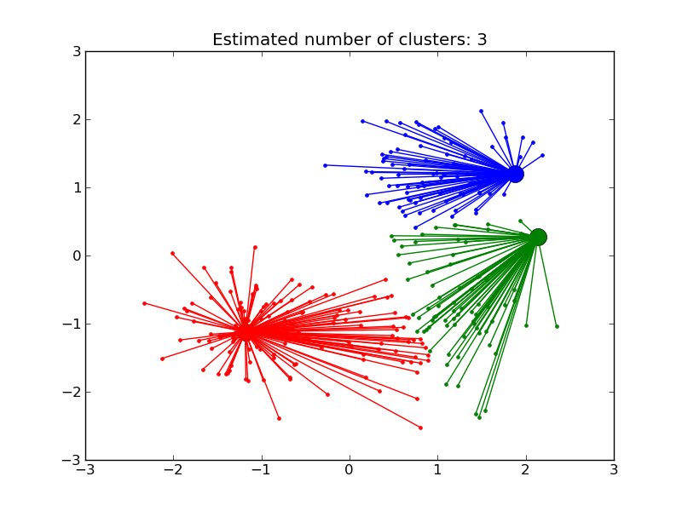
Clustering
Used SciKit-learn library
Use infinity propagation algorithm.
Other algorithm could increase performance perhaps. (Learning experience)

Slide 5
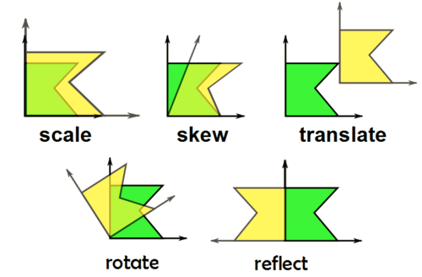
Image transformation
Used affine transformation, to map QR code images on to background images.
When used with NumPy, it forms matrix inversions.

Slide 6
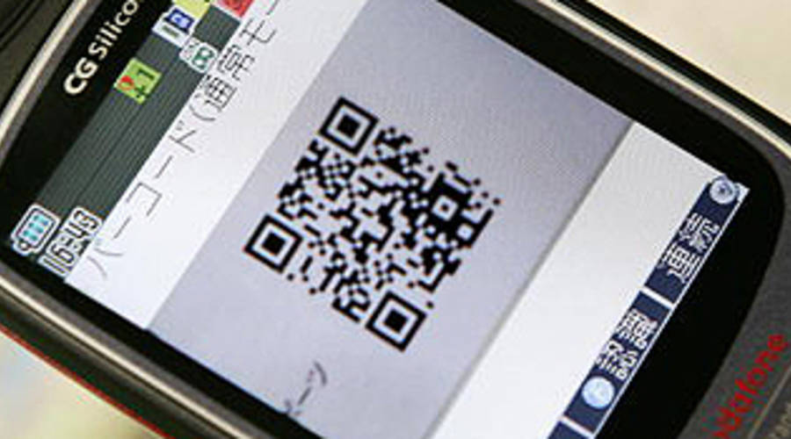
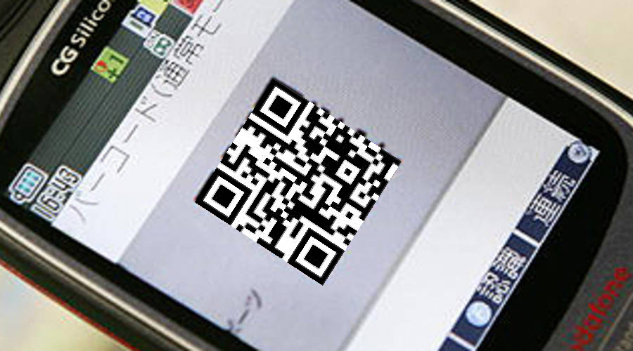
What it looks like

Slide 7






WHAT DID WE USE?

Slide 9

QA?

